Slide 1
IoT Network Architecture and Design
Module-1[Chapter-2]

Slide 2
Network Layer:
It is the communication domain for IoT devices and end-points.
It includes the devices themselves and the communications network that links them.
Includes wireless mesh technologies, such as 802.15.4 and wireless point-to-multipoint systems such as IEEE801.1ah.
It also includes wired device such as IEEE1901 power line communications.
The device simply communicate through a field area network(FAN) to use-specific apps in the IoT application domain.
The device domain also includes the gateway device, which provides communications up into the core network and acts as a demarcation point between device and network domains

Slide 3
IIT and IoT Difference
IT systems are mostly concerned with reliable and continuous support of business applications such as email, web, databases, CRM systems and so on.
IoT is all about the data generated from sensors and how data is used. The essence of IoT architecture involves how the data is generated by sensors and that data is used. The essence of IoT architectures thus involves how the data is transported, collected, analyzed and ultimately acted upon.

Slide 4
IoT Architectural Drivers
Challenge | Description | IoT Architectural Change Required
Scale | The massive scale of IoT end-points is far beyond that of typical IT networks | The IPv4 address space has reached exhaustion and is unable to meet IoTs scalability requirements. Scale can be met only by using IPv4 through features like Network Address Translation.
Security | IoT devices, especially those on wireless sensor networks(WSNs) are often physically exposed to the world. | Security is required at every level of the IoT network. Every IoT endpoint node on the network must be part of the overall security strategy and must support device-level authentication and link encryption. It must also be easy to deploy with some type of a zero-touch deployment model.
Device and networks constrained by power, CPU, memory and link speed | Due to the massive scale and longer distances the networks are often constrained, lossy, and capable of supporting only minimal data rates. | New last-mile wireless technologies are needed to support constrained IoT devices over long distances. The network is also constrained, meaning modification need to be made to traditional network-layer transport mechanism.
The massive volume of data generated | The sensor generate a massive amount of data on a daily basis, causing network bottlenecks and slow analytics in the cloud. | Data analytics capabilities need to be distributed throughout the IoT network, from the edge to the cloud. In traditional IT networks, analytics and applications typically run only in the cloud.

Slide 5
IoT Architectural Drivers
Challenge | Description | IoT Architectural Change Required
Support for legacy devices | An IoT network often comprises a collection of modern, IT-capable endpoints as well as legacy, non-IP devices that rely on serial or proprietary protocols | Digital transformation is a long process that may take many years and IoT networks need to support protocol translation and/or tunnelling mechanism to support legacy protocols over standards-based protocols such as Ethernet and IP.
The need for data to be analyzed in real time | Whereas traditional IT networks perform scheduled batch processing of data needs to be analyzed and responded to in real-time | Analytics software needs to be positioned closer to the edge and should support real-time streaming analytics. Traditional IT analytics software are better suited to batch-level analytics that occur after the fact.

Slide 6
Scale
The scale of a typical IT network is on the order of several thousand devices—typically printers, mobile wireless devices, laptops, servers, and so on.
The traditional three-layer campus networking model, supporting access, distribution, and core (with sub architectures for WAN, Wi-Fi, data center, etc.), is well understood.

Slide 7
Security
It has often been said that if World War III breaks out, it will be fought in cyberspace. We have already seen evidence of targeted malicious attacks using vulnerabilities in networked machines, such as the outbreak of the Stuxnet worm, which specifically affected Siemens programmable logic controller (PLC) systems.
The frequency and impact of cyber attacks in recent years has increased dramatically. Protecting corporate data from intrusion and theft is one of the main functions of the IT department. IT departments go to great lengths to protect servers, applications, and the network, setting up defense-in-depth models with layers of security designed to protect the cyber crown jewels of the corporation.
In IT networks, the first line of defense is often the perimeter firewall. It would be unthinkable to position critical IT endpoints outside the firewall, visible to anyone who cared to look.

Slide 8
Security
For example, at 3:30 p.m. on December 23, 2015, the Ukrainian power grid experienced an unprecedented cyber attack that affected approximately 225,000 customers. This attack wasn’t simply carried out by a group of opportunistic thieves; it was a sophisticated, well-planned assault on the Ukrainian power grid that targeted the SCADA (supervisory control and data acquisition) system, which governs communication to grid automation devices. For optimum security, IoT systems must:
■ Be able to identify and authenticate all entities involved in the IoT service (that is, gateways, endpoint devices, home networks, roaming networks, service platforms)
■ Ensure that all user data shared between the endpoint device and back-end applications is encrypted
■ Comply with local data protection legislation so that all data is protected and stored correctly
■ Utilize an IoT connectivity management platform and establish rules-based security policies so immediate action can be taken if anomalous behavior is detected from connected devices
■ Take a holistic, network-level approach to security

Slide 9
Constrained Devices and Networks
IoT sensors are designed for a single job, and they are typically small and inexpensive. This means they often have limited power, CPU, and memory, and they transmit.
Because of the massive scale of these devices and the large, uncontrolled environments where they are usually deployed, the networks that provide connectivity also tend to be very lossy and support very low data rates.
This is a completely different situation from IT networks, which enjoy multi-gigabit connection speeds and endpoints with powerful CPUs.
If an IT network has performance constraints, the solution is simple: Upgrade to a faster network. If too many devices are on one VLAN and are impacting performance, you can simply carve out a new VLAN and continue to scale as much as you need.

Slide 10
Data
IoT devices generate a mountain of data. In general, most IT shops don’t really care much about the unstructured chatty data generated by devices on the network.
In IoT the data is like gold, as it is what enables businesses to deliver new IoT services that enhance the customer experience, reduce cost, and deliver new revenue opportunities.
Although most IoT-generated data is unstructured, the insights it provides through analytics can revolutionize processes and create new business models.

Slide 11
A smart city with a few hundred thousand smart streetlights, all connected through an IoT network. The information communicated between the lighting network modules and the control center is of little interest to anyone, patterns in this data can yield extremely useful insights that can help predict when lights need to be replaced or whether they can be turned on or off at certain times, thus saving operational expense.
When all this data is combined, it can become difficult to manage and analyze effectively. Unlike IT networks, IoT systems are designed to stagger data consumption
throughout the architecture, both to filter and reduce unnecessary data going upstream and to provide the fastest possible response to devices when necessary.

Slide 12
Legacy Device Support
Legacy devices in an IT organization is not usually a big problem. If someone is using a mobile device with an outdated Wi-Fi standard, such as 802.11b or 802.11g, you can simply deny him access to the wireless network, and he will be forced to upgrade.
In OT systems, end devices are likely to be on the network for a very long time—sometimes decades. As IoT networks are deployed, they need to support the older devices already present on the network, as well as devices with new capabilities. In many cases, legacy devices are so old that they don’t even support IP.
For example, a factory may replace machines only once every 20 years—or perhaps even longer! It does not want to upgrade multi-million-dollar machines just so it can connect them to a network for better visibility and control.

Slide 13
Comparing IoT Architectures
The aforementioned challenges and requirements of IoT systems have driven a whole new discipline of network architecture. In the past several years, architectural standards and frameworks have emerged to address the challenge of designing massive-scale IoT networks.
The foundational concept in all these architectures is supporting data, process, and the functions that endpoint devices perform.
Two of the best-known architectures are those supported by oneM2M and the IoT World Forum.

Slide 14
The oneM2M IoT Standardized Architecture
To standardize the rapidly growing field of machine-to-machine (M2M) communications, the European Telecommunications Standards Institute (ETSI) created the M2M Technical Committee in 2008.
In 2012 ETSI and 13 other founding members launched oneM2M as a global initiative designed to promote efficient M2M communication systems and IoT.
The goal of oneM2M is to create a common services layer, which can be readily embedded in field devices to allow communication with application servers.
oneM2M’s framework focuses on IoT services, applications, and platforms. These include smart metering applications, smart grid, smart city automation, e-health, and connected vehicles.

Slide 15
The greatest challenges in designing an IoT architecture is dealing with the heterogeneity of devices, software, and access methods. By developing a horizontal platform architecture, oneM2M is developing standards that allow interoperability at all levels of the IoT stack.
For example, you might want to automate your HVAC system by connecting it with wireless temperature sensors spread throughout your office.

Slide 16
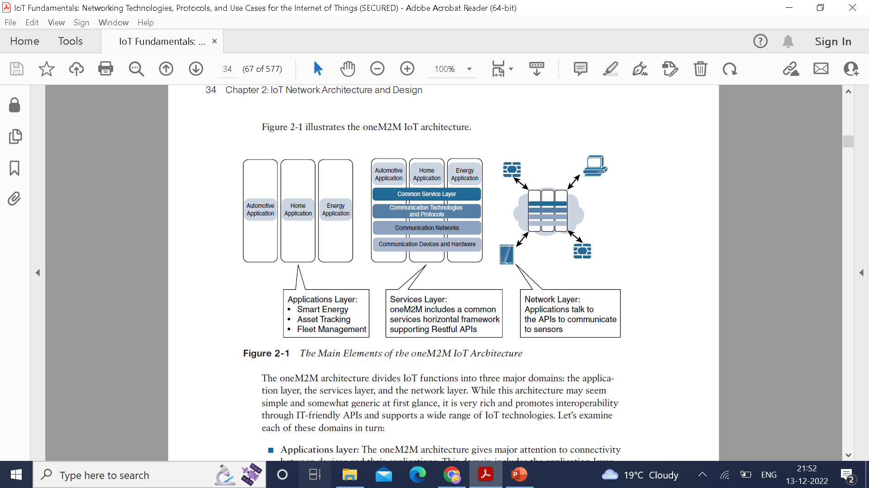

Slide 17
Applications layer:
The oneM2M architecture gives major attention to connectivity between devices and their applications. This domain includes the application-layer protocols and attempts to standardize northbound API definitions for interaction with business intelligence (BI) systems.
Applications tend to be industry-specific and have their own sets of data models, and thus they are shown as vertical entities.
Services layer:
This layer is shown as a horizontal framework across the vertical industry applications. At this layer, horizontal modules include the physical network that the IoT applications run on, the underlying management protocols, and the hardware. Examples include backhaul communications via cellular, MPLS networks, VPNs, and so on. Riding on top is the common services layer.

Slide 18
This conceptual layer adds APIs and middleware supporting third-party services and applications.
One of the stated goals of oneM2M is to “develop technical specifications which address the need for a common M2M Service Layer that can be readily embedded within various hardware and software nodes, and rely upon connecting the myriad of devices in the field area network to M2M application servers, which typically reside in a cloud or data center.”
A critical objective of oneM2M is to attract and actively involve organizations from M2M-related business domains, including telematics and intelligent transportation, healthcare, utility, industrial automation, and smart home Applications.

Slide 19
The IoT World Forum (IoTWF) standardized Architecture
In 2014 the IoTWF architectural committee published a seven-layer IoT reference model.
IoT world Forum offers a clean, simplified perspective on IoT and includes edge computing, data storage and access.
Seven layers is broken into specific functions, and security encompasses the entire model.
IoT reference model defines a set of levels with control flowing the center, to the edge, which includes sensors, devices, machines and other types of intelligent end nodes.
Data travels up the stack, originating from the edge, and goes northbound to the center.

Slide 20
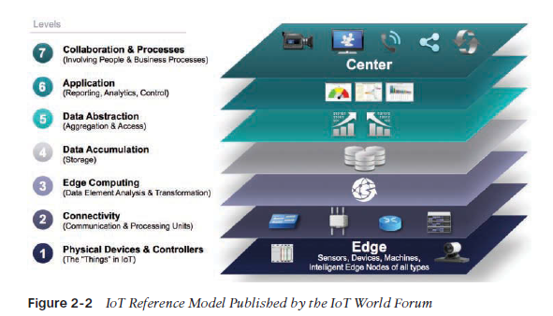

Slide 21
Using the reference model the following can be achieved:
Decompose the IoT problem into smaller parts.
Identify different technologies at each layer and how they relate to one another
Define a system in which different parts can be provided by different vendors
Have a process of defining interfaces that leads to interoperability
Define a tiered security model that is enforced at the transition points between levels

Slide 22
Layer 1: Physical Devices and Controllers Layers
The first layer of the IoT Reference Model is the physical devices and controllers layer.
This layer is home to the “things” in the Internet of Things, including the various endpoint devices and sensors that send and receive information.
The size of these “things” can range from almost microscopic sensors to giant machines in a factory.
Their primary function is generating data and being capable of being queried and/or controlled over a network.

Slide 23
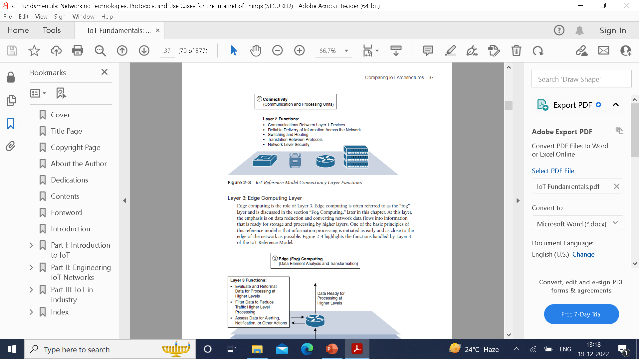
Layer 2: Connectivity Layer
In the second layer of the IoT Reference Model, the focus is on connectivity. The most important function of this IoT layer is the reliable and timely transmission of data.
More specifically, this includes transmissions between Layer 1 devices and the network and between the network and information processing that occurs at Layer 3 .
The connectivity layer encompasses all networking elements of IoT and doesn’t really distinguish between the last-mile network (the network between the sensor/endpoint and the IoT gateway, discussed later in this chapter), gateway, and backhaul networks.

Slide 24
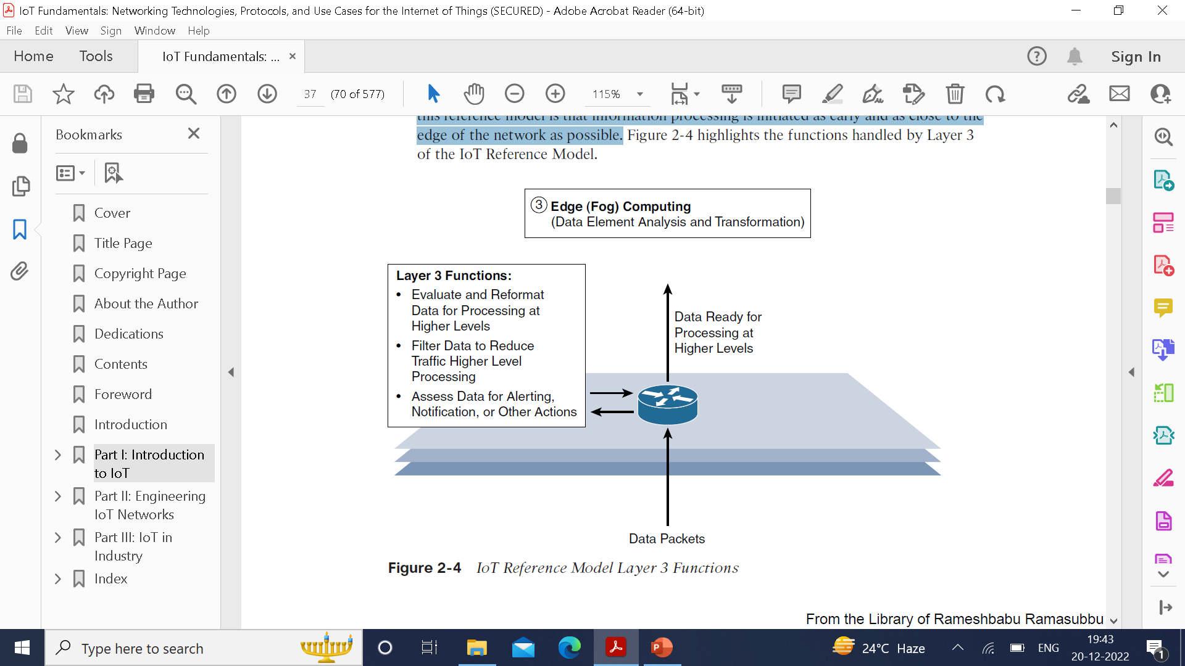
Layer 3: Edge Computing Layer
Edge computing is often referred to as the “fog” layer.
This layer emphasis is on the data reduction and converting network data flows into information that is ready for storage and processing by higher layers.
One of the basic principles of this reference model is that information processing is initiated as early and as close to the edge of the network as possible.

Slide 25
Upper Layers 4-7:
IoT Reference Model Layer | Functions
Layer 4: Data accumulation layer | Captures data and stores it so it is usable by applications when necessary. Converts event-based data to query-based processing.
Layer 5: Data abstraction layer | Reconciles multiple data formats and ensures consistent semantics from various sources. Confirms that the data set is complete and consolidates data into one place or multiple data stores using virtualization.
Layer 6: Applications layer | Interprets data using software applications. Applications may monitor, control, and provide reports based on the analysis of the data.
Layer 7: Collaboration and processes layer | Consumes and shares the application information. Collaborating on and communicating IoT information often requires multiple steps, and it is what makes IoT useful. This layer can change business processes and delivers the benefits of IoT.

Slide 26
IT and OT Responsibilities in the IoT Reference Model
IoT systems have to cross several boundaries beyond just the functional layers. The bottom of the stack is generally in the domain of OT. For an industry like oil and gas, this includes sensors and devices connected to pipelines, oil rigs, refinery machinery, and so on.
The top of the stack is in the IT area and includes things like the servers, databases, and applications, all of which run on a part of the network controlled by IT. In the past, OT and IT have generally been very independent and had little need to even talk to each other. IoT is changing that paradigm.
At the bottom, in the OT layers, the devices generate real-time data at their own rate—sometimes vast amounts on a daily basis. Not only does this result in a huge amount of data transiting the IoT network, but the sheer volume of data suggests that applications at the top layer will be able to ingest that much data at the rate required.
To meet this requirement, data has to be buffered or stored at certain points within the IoT stack. Layering data management in this way throughout the stack helps the top four layers handle data at their own speed.

Slide 27
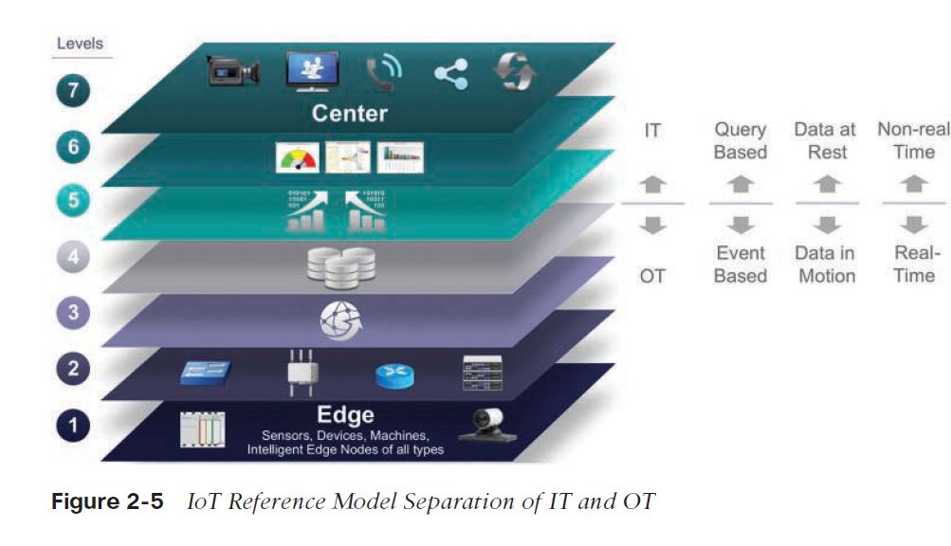

Slide 28
Additional IoT Reference Models
IoT Reference Model | Description
Purdue Model for Control Hierarchy | The Purdue Model for Control Hierarchy (see www.cisco.com/c/en/us/td/docs/solutions/Verticals/EttF/EttFDIG/ch2_EttF.pdf) is a common and well-understood model that segments devices and equipment into hierarchical levels and functions. It is used as the basis for ISA-95 for control hierarchy, and in turn for the IEC-62443 (formerly ISA-99) cyber security standard. It has been used as a base for many IoT-related models and standards across industry.
Industrial Internet Reference Architecture (IIRA) by Industrial Internet Consortium (IIC) | The IIRA is a standards-based open architecture for Industrial Internet Systems (IISs). To maximize its value, the IIRA has broad industry applicability to drive interoperability, to map applicable technologies, and to guide technology and standard development. The description and representation of the architecture are generic and at a high level of abstraction to support the requisite broad industry applicability. The IIRA distills and abstracts common characteristics, features and patterns from use cases well understood at this time, predominantly those that have been defined in the IIC.

Slide 29
IoT Reference Model | Description
Internet of Things– Architecture (IoT-A) | IoT-A created an IoT architectural reference model and defined an initial set of key building blocks that are foundational in fostering the emerging Internet of Things. Using an experimental paradigm, IoT-A combined top-down reasoning about architectural principles and design guidelines with simulation and prototyping in exploring the technical consequences of architectural design choices.

Slide 30
A Simplified IoT Architecture
The commonality between these frameworks is that they all recognize the interconnection of the IoT endpoint devices to a network that transports the data where it is ultimately used by applications, whether at the data center, in the cloud, or at various management points throughout the stack.
This framework is presented as two parallel stacks: The IoT Data Management and Compute Stack and the Core IoT Functional Stack. Reducing the framework down to a pair of three-layer stacks in no way suggests that the model lacks the detail necessary to develop a sophisticated
IoT strategy. Rather, the intention is to simplify the IoT architecture into its most basic building blocks and then to use it as a foundation to understand key design and deployment principles that are applied to industry-specific use cases. All the layers of more complex models are still covered, but they are grouped here in functional blocks that are easy to understand.

Slide 31
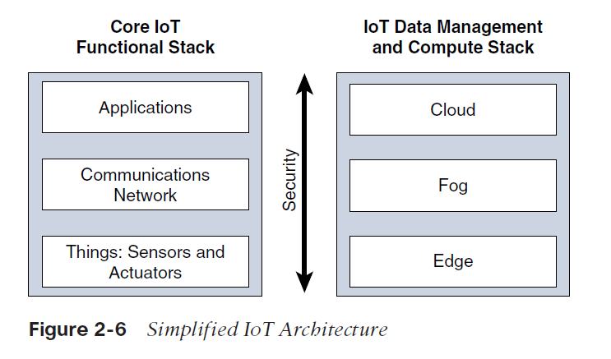

Slide 32
The presentation of the core IoT Functional stack in three layers is meant to simplify the understanding of IoT architecture.
The network communications layer of the IoT stack itself involves a significant amount of detail and incorporates a vast array of technologies.
Heterogeneity of IoT sensors and many different ways that exists to connect them to a network. The network communications layer needs to consolidate these together offer gateway and backhaul technologies and bring back the data to a central location for analysis and processing.
The network between the gateway and the data center is composed mostly of traditional technologies that experienced IT professionals would quickly recognize. These include tunneling and VPN technologies, IP-based quality of service (QoS), conventional Layer 3 routing protocols such as BGP and IP-PIM, and security capabilities such as encryption, access control lists (ACLs), and firewalls.

Slide 33
The unique challenges and requirements of IoT, it is often necessary to deploy applications and data management throughout the architecture in a tiered approach, allowing data collection, analytics, and intelligent controls at multiple points in the IoT system.
The three data management layers are:
Edge-data management within the sensors
fog- data management in the gateways and transit network
cloud- data management in the cloud or central data center

Slide 34
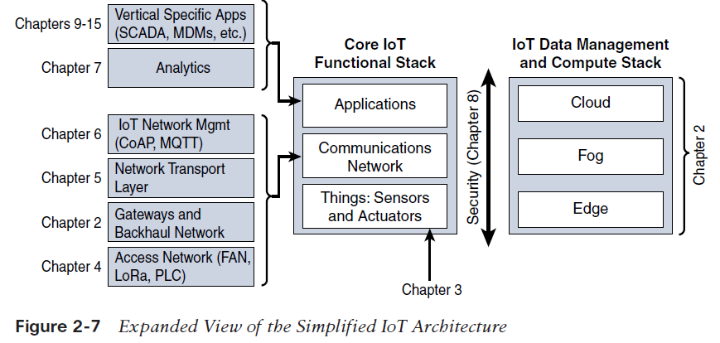

Slide 35
The core IoT Functional Stack
From architectural standpoint, several components have to work together for IoT network to be operational:
“Things” layer: The physical devices need to fit the constraints of the environment in which they are deployed while still being able to provide the information needed.
Communication network layer: It uses a wireless technology. It has four sublayers:
Access network sublayer: The IoT network is the access network. It is typically made up of wireless technology such as 802.11ah, 802.15.4g, and LoRa. The sensors connected to the access network may also be wired.
Gateways and backhaul network sublayer: gateways forwards the collected information through long range medium. Also forwards one IP network to another, therefore acts as a router.
Network transport layer: for successful communication, network and transport layer protocols such as IP and UDP must be implemented to support the variety of devices to connect and media in use.
IoT network management sublayer: To allow the headend applications to exchange data with the sensors. Examples: CoAP and MQTT.

Slide 36
Applications and analytics layer:
To process the collected data, not only to control the smart objects when necessary, but to make intelligent decision based on the information collected and in turn instruct the “things” or other systems to adapt the analyzed conditions and change their behavior.

Slide 37
Layer 1: Things Sensors and Actuators Layers
Battery-powered or power-connected
Mobile or static
Low or high reporting frequency
Simple or rich data
Report range
Object density per cell

Slide 38
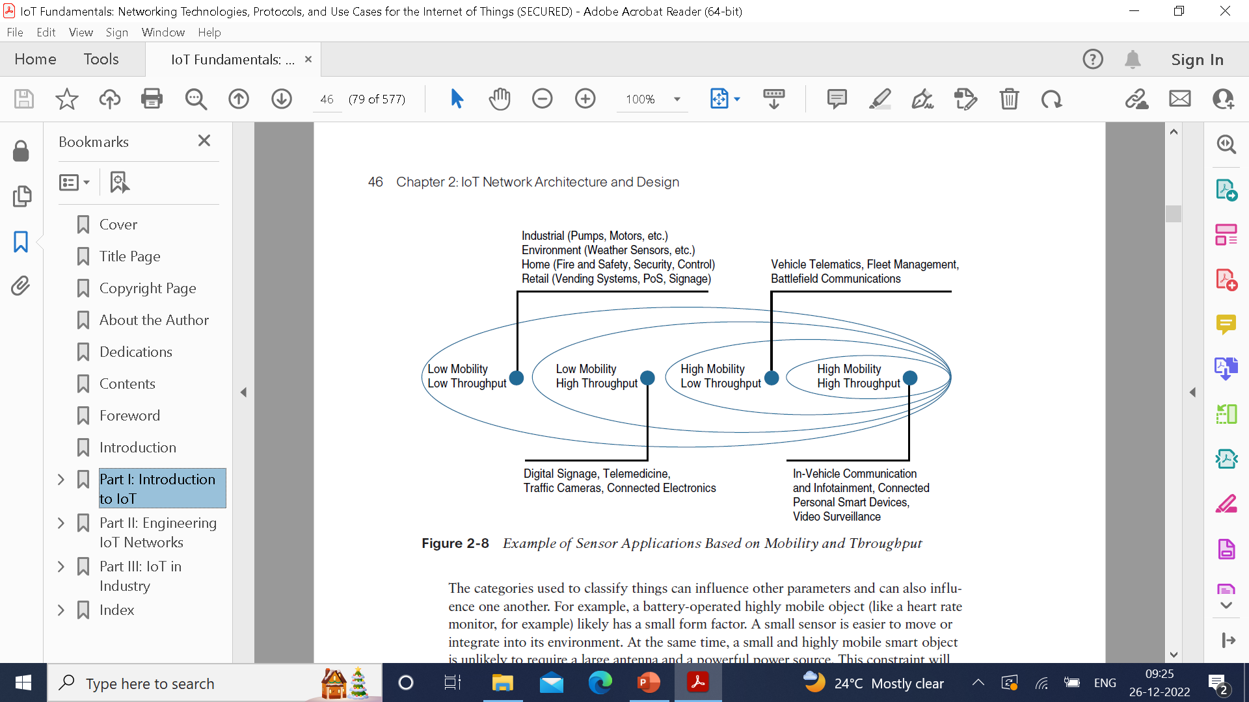

Slide 39
Layer 2: Communication Network Layer
Compute and network assets used in IoT can be very different from those in IT environment. The difference in the physical form factors between devices used by IT and OT is casual in observers.
Device mounting is one obvious difference between OT and IT.
Compute and communication assets are placed within enclosed space, such as a control cabinet where they will be vertically mounted on a DIN(Deutsches Institute fur Normung) rail inside.
Power supplies are also seen on standard IT equipment.

Slide 40
Access Network Sublayer
There is a relationship between the IoT network technology and the type of connectivity topology.
These use cases determine the frequency band that was expected to be most suitable, the frame structure matching the expected data pattern.
Key parameter determining the choice of access technology is the range between the smart object and the information collector.
PAN(Personal Area Network): scale of a few meters. Example Bluetooth
HAN(Home Area Network): scale of a few 10 meters. ZigBee and BLE.
NAN(Neighborhood Area Network): scale of a few hundred meters.
FAN(Field Area Network): Scale of several tens of meters to several hundred meters. Typically refers to an outdoor area larger than a single group of house units.
LAN(Local Area Network): scale upto 100 meters. Other classifications are MAN and WAN.

Slide 41
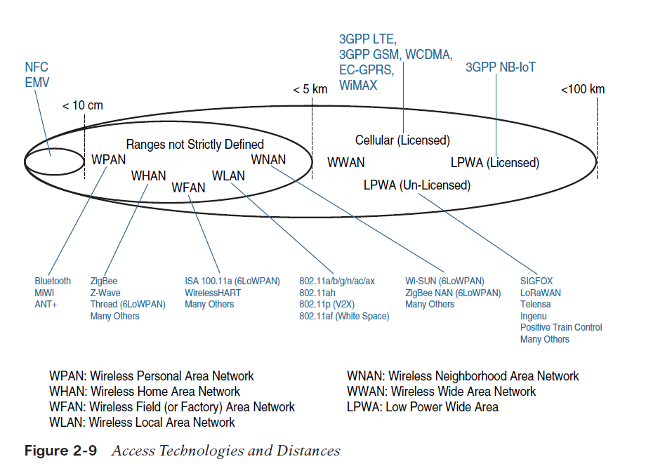

Slide 42
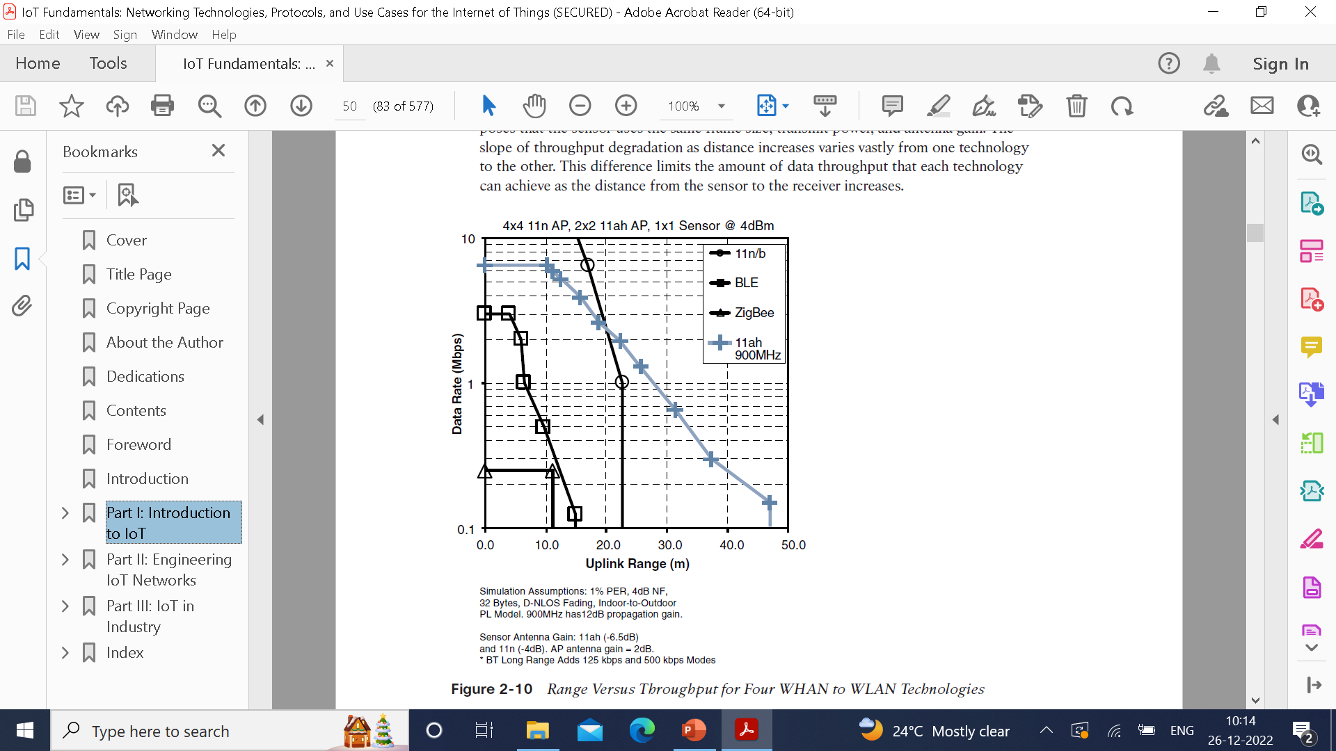
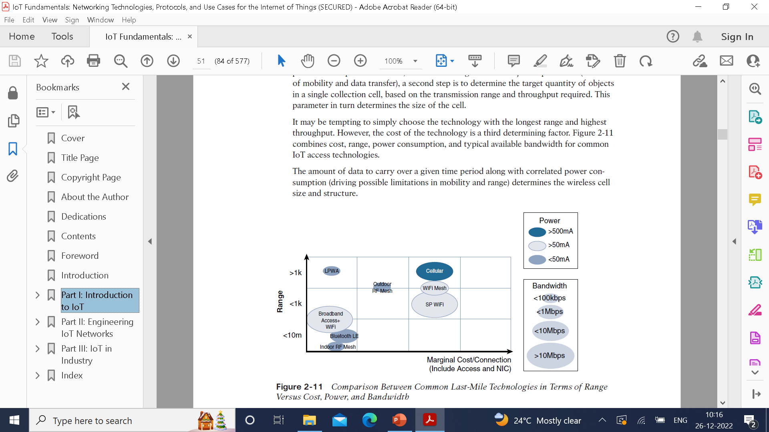

Slide 43
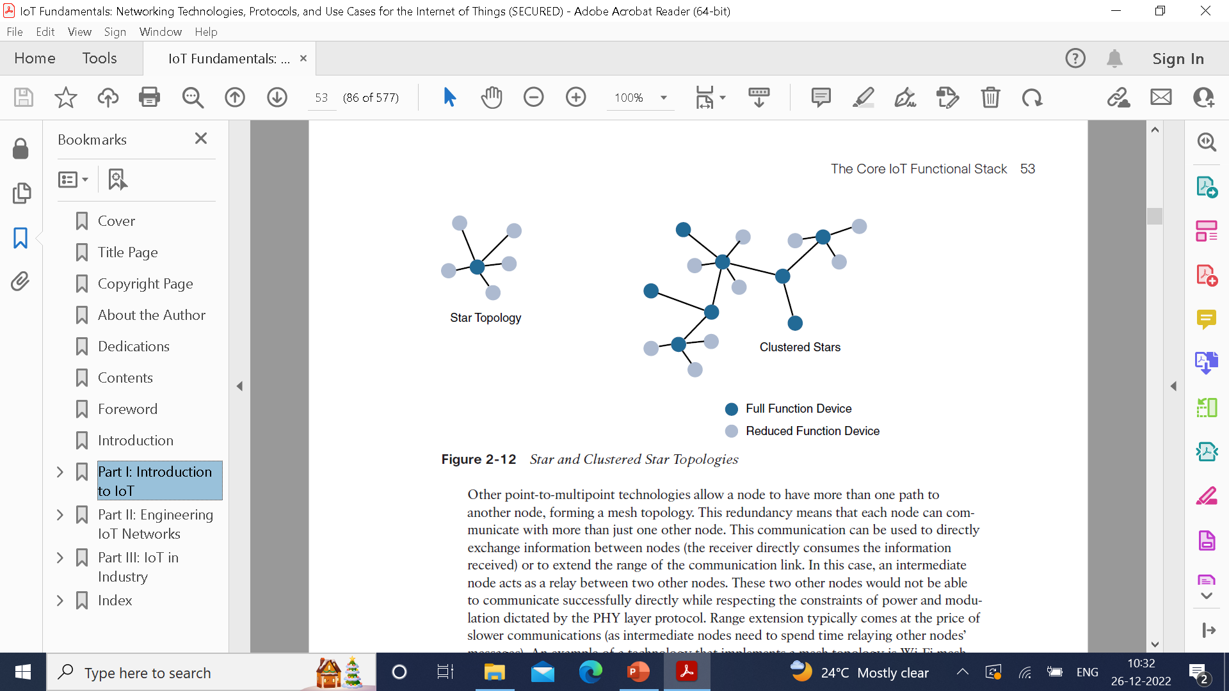
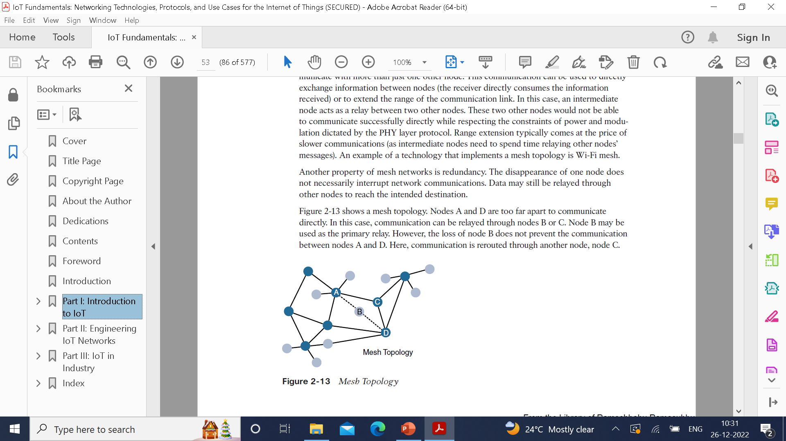
Point-to-point topologies : Allows one point to communicate with another point. It often refers to the communication structure more than the physical topology.
Point-to-multipoint topologies: Allows one point to more than one other point.
The sensor can implement a subset of protocol functions to perform just a specialized part. Such a device is called a reduced-function device(RFD). An RFD cannot implement direct communications to another RFD.
The coordinator that implements the full network functions is called a full-function device. An FFD can communicate directly with another FFD or with more than one FFD, forming peer-to-peer connections. Topologies where each FFD has a unique path to another FFD are called cluster tree topologies.

Slide 44
Gateways and Backhaul Sublayer
Data collected from a smart object may need to be forwarded to a central station where data is processed. As this station is often in a different location from the smart object, data directly received from the sensor through an access technology needs to be forwarded to another medium (the backhaul) and transported to the central station.
The gateway is in charge of this inter-medium communication. The smart objects are static or mobile within a limited area. The dedicated short-range communication (DSRC) allows vehicle-to-vehicle and vehicle-to infrastructure communication.
In this model, the smart object’s position relative to the gateway is static. The car includes sensors and one gateway. Communication between the sensors and the gateway may involve wired or wireless technologies.
Sensors may also be integrated into the road infrastructure and connect over a wired or wireless technology to a gateway on the side of the road. A wireless technology (DSRC operates in the upper 5 GHz range) is used for backhaul communication, peer-to-peer, or mesh communication between vehicles.

Slide 45
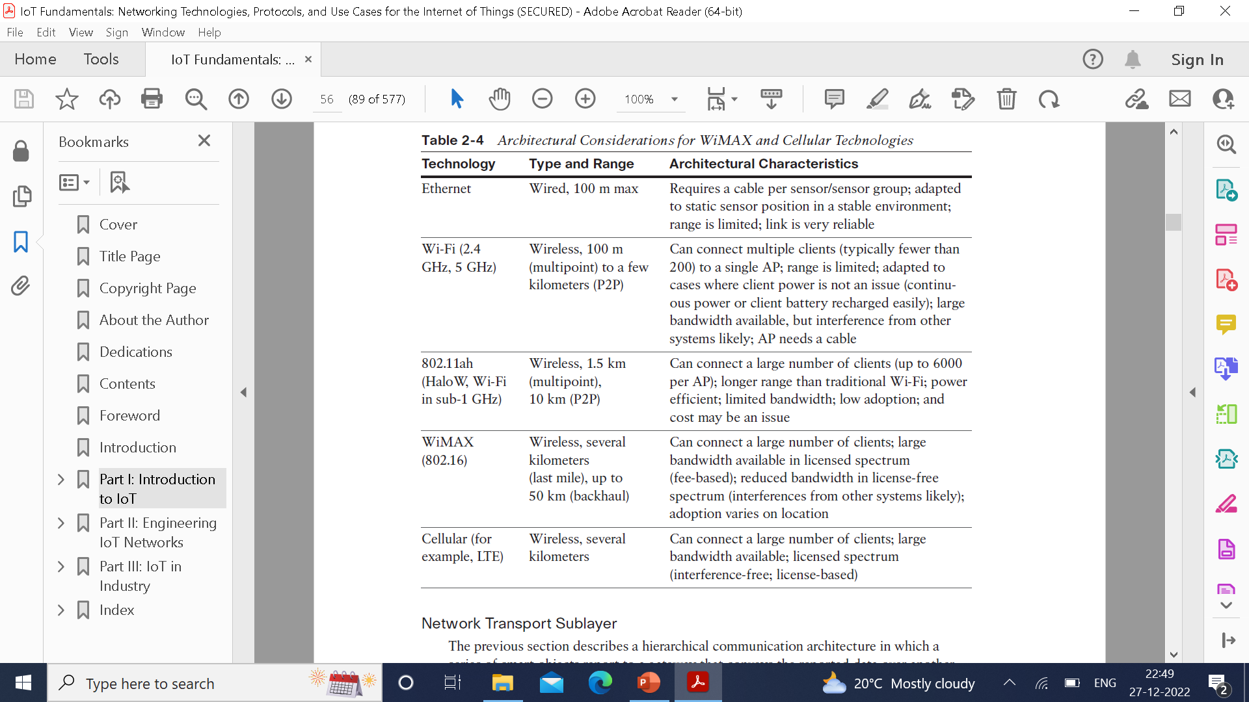

Slide 46
Network Transport Sublayer
This communication structure thus may involve peer-to-peer (for example, meter to meter), point-to-point (meter to headend station), point-to-multipoint (gateway or headend to multiple meters), unicast and multicast communications (software update to one or multiple systems).
In a multitenant environment (for example, electricity and gas consumption management), different systems may use the same communication pathways.
This communication occurs over multiple media (for example, power lines inside your house or a short-range wireless system like indoor Wi-Fi and/or ZigBee), a longer-range wireless system to the gateway, and yet another wireless or wired medium for backhaul transmission.
The flexibility of IP allows this protocol to be embedded in objects of very different natures, exchanging information over very different media, including low-power, lossy, and low-bandwidth networks. For example, RFC 2464 describes how an IPv6 packet gets encapsulated over an Ethernet frame and is also used for IEEE 802.11 Wi-Fi.

Slide 47
Finally, the transport layer protocols built above IP (UDP and TCP) can easily be leveraged to decide whether the network should control the data packet delivery (with TCP) or whether the control task should be left to the application (UDP). UDP is a much lighter and faster protocol than TCP.

Slide 48
IoT Network Management Sublayer
IP, TCP, and UDP bring connectivity to IoT networks. Upper-layer protocols need to take care of data transmission between the smart objects and other systems. Multiple protocols have been leveraged or created to solve IoT data communication problems.
To respond to the limits of web-based protocols, another protocol was created by the IETF Constrained Restful Environments (CoRE) working group: Constrained ApplicationProtocol (CoAP). CoAP uses some methods similar to those of HTTP (such as Get, Post, Put, and Delete) but implements a shorter list, thus limiting the size of the header.
CoAP also runs on UDP (whereas HTTP typically uses TCP). CoAP also adds a feature that is lacking in HTTP and very useful for IoT: observation. Observation allows the streaming of state changes as they occur, without requiring the receiver to query for these changes.

Slide 49
Another common IoT protocol utilized in these middle to upper layers is Message Queue Telemetry Transport (MQTT). MQTT uses a broker-based architecture.
The sensor can be set to be an MQTT publisher (publishes a piece of information), the application that needs to receive the information can be set as the MQTT subscriber, and any intermediary system can be set as a broker to relay the information between the publisher and the subscriber(s).
MQTT runs over TCP. A consequence of the reliance on TCP is that an MQTT client typically holds a connection open to the broker at all times. This may be a limiting factor in environments where loss is high or where computing resources are limited.

Slide 50
Layer 3: Applications and Analytics Layer
From an architectural standpoint, one basic classification can be as follows:
Analytics application: This type of application collects data from multiple smart objects, processes the collected data, and displays information resulting from the data that was processed. The display can be about any aspect of the IoT network, from historical reports, statistics, or trends to individual system states.
Control application: This type of application controls the behavior of the smart object or the behavior of an object related to the smart object. For example, a pressure sensor may be connected to a pump. A control application increases the pump speed when the connected sensor detects a drop in pressure.
Control applications are very useful for controlling complex aspects of an IoT network with a logic that cannot be programmed inside a single IoT object, either because the configured changes are too complex to fit into the local system or because the configured changes rely on parameters that include elements outside the IoT object.

Slide 51
Data Versus Network Analytics
Data analytics
Network analytics

Slide 52
Data Analytics versus Business Benefits
A flexible analytics and control applications is Cisco Jasper, which provides a turnkey cloud-based for IoT management and monitoring.
An alert system can be deployed to avoid delay between the time when a machine goes into the error state and the time when a repair team visits the machine location.

Slide 53
Smart services
The ability to use IoT to improve operations is often termed “smart services.” This term is generic, and in many cases the term is used but its meaning is often stretched to include one form of service or another where an additional level of intelligence is provided.
Smart services can also be used to measure the efficiency of machines by detecting machine output, speed, or other forms of usage evaluation. Entire operations can be optimized with IoT.
In hospitality, for example, presence and motion sensors can evaluate the number of guests in a lobby and redirect personnel accordingly. The same type of action can be taken in a store where a customer is detected as staying longer than the typical amount of time in front of a shelf. Personnel can be deployed to provide assistance.
Movement of people and objects on factory floors can be analyzed to optimize the production flow.
Smart services can be integrated into an IoT system. For example, sensors can be integrated in a light bulb. A sensor can turn a light on or off based on the presence of a human in the room.

Slide 54
An even smarter system can communicate with other systems in the house, learn the human movement pattern, and anticipate the presence of a human, turning on the light just before the person enters the room.
An even smarter system can use smarter sensors that analyze multiple parameters to detect human mood and modify accordingly the light color to adapt to the learned preferences, or to convey either a more relaxing or a more dynamic environment.
Light bulbs are a simple example. By connecting to other systems in the house, efficiencies can be coordinated. For example, the house entry alarm system or the heating system can coordinate with the presence detector in a light bulb to adapt to detected changes.
The alarm system can disable volumetric movement alarms in zones where a known person is detected. The heating system can adapt the temperature to human presence or detected personal preferences.

Slide 55
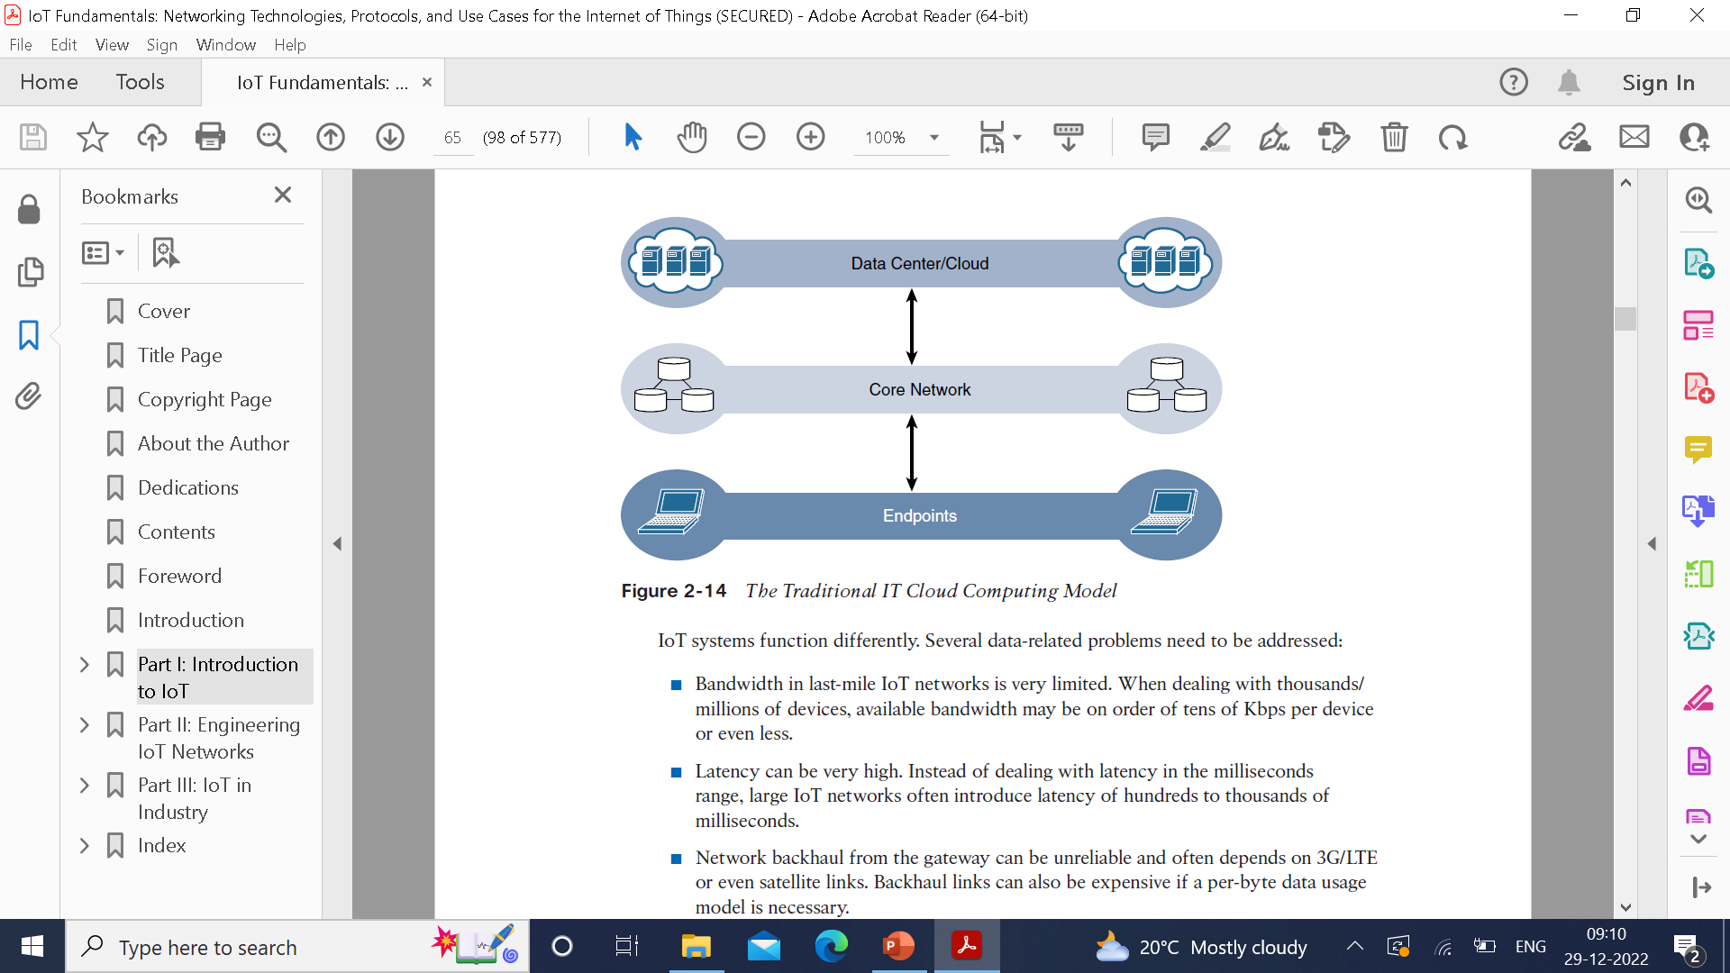
IoT Data Management and Compute Stack
New requirements are:
Minimizing the latency
Conserving network bandwidth
Increasing local efficiency
Data management in traditional IT is simple. The endpoints communicate over an IP core network to servers in the data center or cloud.

Slide 56
IoT systems function differently. Several data-related problems need to be addressed:
■ Bandwidth in last-mile IoT networks is very limited. When dealing with thousands/ millions of devices, available bandwidth may be on order of tens of Kbps per device or even less.
■ Latency can be very high. Instead of dealing with latency in the milliseconds range, large IoT networks often introduce latency of hundreds to thousands of milliseconds.
■ Network backhaul from the gateway can be unreliable and often depends on 3G/LTE or even satellite links. Backhaul links can also be expensive if a per-byte data usage model is necessary.
■ The volume of data transmitted over the backhaul can be high, and much of the data may not really be that interesting (such as simple polling messages).
■ Big data is getting bigger. The concept of storing and analyzing all sensor data in the cloud is impractical. The sheer volume of data generated makes real-time analysis and response to the data almost impossible.

Slide 57
Fog Computing
The best-known embodiment of edge services in IoT is fog computing. Any device with computing, storage, and network connectivity can be a fog node. Examples include industrial controllers, switches, routers, embedded servers, and IoT gateways.
Analyzing IoT data close to where it is collected minimizes latency, offloads gigabytes of network traffic from the core network, and keeps sensitive data inside the local network.
An advantage of this structure is that the fog node allows intelligence gathering (such as analytics) and control from the closest possible point, and in doing so, it allows better performance over constrained networks.
Fog services are typically accomplished very close to the edge device, sitting as close to the IoT endpoints as possible.

Slide 58
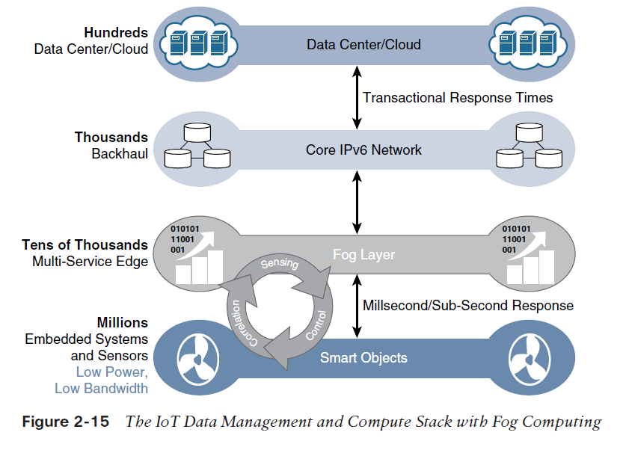

Slide 59
IoT fog computing enables data to be preprocessed and correlated with other inputs to produce relevant information. This data can then be used as real-time, actionable knowledge by IoT-enabled applications. Longer term, this data can be used to gain a deeper understanding of network behavior and systems for the purpose of developing proactive policies, processes, and responses.
Fog applications are as diverse as the Internet of Things itself. What they have in common is data reduction—monitoring or analyzing real-time data from network-connected things and then initiating an action, such as locking a door, changing equipment settings, applying the brakes on a train, zooming a video camera, opening a valve in response to a pressure reading, creating a bar chart, or sending an alert to a technician to make a preventive repair.

Slide 60
The defining characteristic of fog computing are as follows:
Contextual location awareness and low latency: The fog node sits as close to the IoT endpoint as possible to deliver distributed computing.
Geographic distribution: In sharp contrast to the more centralized cloud, the services and applications targeted by the fog nodes demand widely distributed deployments.
Deployment near IoT endpoints: Fog nodes are typically deployed in the presence of a large number of IoT endpoints. For example, typical metering deployments often see 3000 to 4000 nodes per gateway router, which also functions as the fog computing node.
Wireless communication between the fog and the IoT endpoint: Although it is possible to connect wired nodes, the advantages of fog are greatest when dealing with a large number of endpoints, and wireless access is the easiest way to achieve such scale.
Use for real-time interactions: Important fog applications involve real-time interactions rather than batch processing. Preprocessing of data in the fog nodes allows upper-layer applications to perform batch processing on a subset of the data.

Slide 61
Edge Computing
Edge computing is also sometimes called “mist” computing. If clouds exist in the sky, and fog sits near the ground, then mist is what actually sits on the ground. Thus, the concept of mist is to extend fog to the furthest point possible, right into the IoT endpoint device itself.

Slide 62
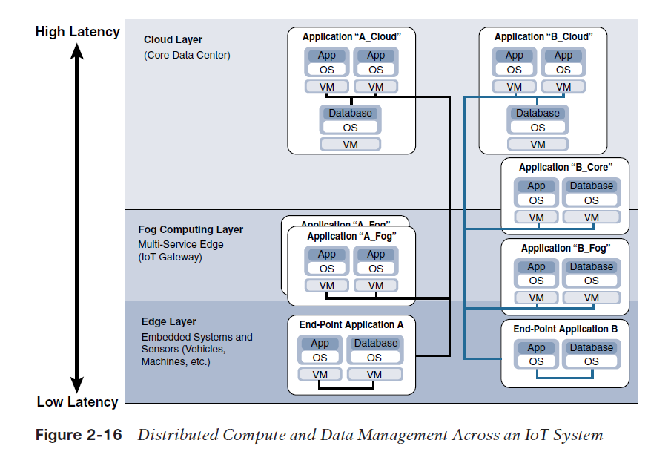
The Hierarchy of Edge, Fog, and Cloud

